Slide 1
Business Continuity Planning
~ Workshop Part 2 ~
Customer Service Centre

Slide 2
This document will review:
Do you know what you need and do you have it?
Now that you have it, do you know what to do with it?
What do you do when something happens?
Who’s in charge?
Supporting Customers
Who ya gonna call?
Who ya gonna tell?
Next step: practice scenario

Slide 3
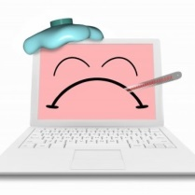
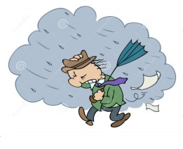
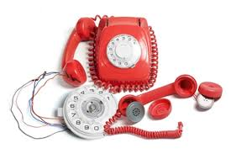
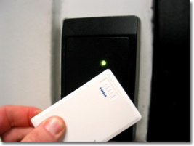


Example Scenarios that may affect Customer Service
      System Outage(s)
      Inclement weather
Phones or VPN Unavailable
      Access to Building
      Contagious disease outbreak
      Leaders Unavailable

Slide 4
Something bad happens….What do you do?
#1 – Are you safe?
If yes, then try the following:
Contact your Supervisor/Mandy or Elaine and let them know your status (What if you can’t reach any of the above? Refer to “Who Ya Gonna Call?” and “Who Ya Gonna Tell?” matrix)
Check for updates over email (Microsoft online)
Keep phone numbers and cells handy
Try to communicate over Chat (Pidgin or Skype) if you are able to connect to the VPN (the network).
Check the Teranet Crisis line
Seek more information – check social sites and news and pass around what you heard if you think it’s reliable

Slide 5
Who’s in charge?
Usually it would be a Team Leader, or Manager, however if no one is available, then it should be the most senior staff member available.
Others can help by:
Volunteering to take inventory of your team
Contacting people via their emergency contact information
Worse case scenario – who do you tell? Use email to escalate and broadcast the situation to our Business and IS partners. – see “Who You Gonna Tell?” slide.
Stay logged in if you can – assess if it’s the right thing to at that time. Things to consider: are all of the skill sets covered? Do you know who can change skill sets to open up product support? (Networking can if Leadership is unavailable) Are you the only one logged in? Should you log out so that the call treatment plays the appropriate greetings?

Slide 6

Supporting Customers
In an emergency situation, we will service customers on a best effort basis!
Email (if available)
Zendesk (if available)
Phone queue
Check voicemail
Live chat
Post updates to call treatment and/or Help Centre – things to consider: is there enough help to do this? Who can help with doing this? (Networking can add call greetings, only CSC has access to add messages to Help Centres, however, we can ask LOB to add updates to product sites)
Next day? Check with Teranet Crisis line to see if company is open

Slide 7

“Do you have what you need?” Checklist
Let’s check:
RSA tokens and PINs
Outlook email password for OWA access and URL
Citrix receiver installed on your home PC
Phone numbers for:
  Service Desk
  Teranet Crisis Line
  CSC Conference Bridge
  Supervisors’ mobiles
Everyone’s personal contact info

Slide 8
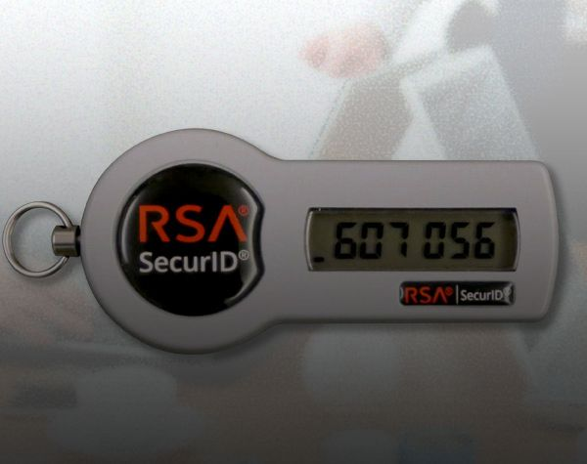
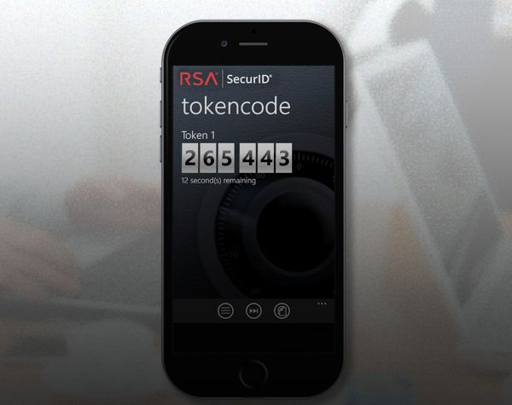
Now that you have it, do you know what to do with it?
RSA SecurID tokens and PINs:
  Used to connect to the network when your VPN router is not available
  They can be either hardware (key fob) or software (smartphone app)
  Two-factor authentication – something that you know = your PIN and something that you are given = 6 digit token code.
  Requires internet connectivity

Slide 9
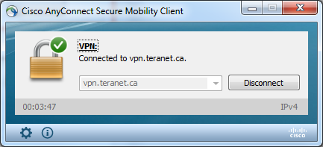
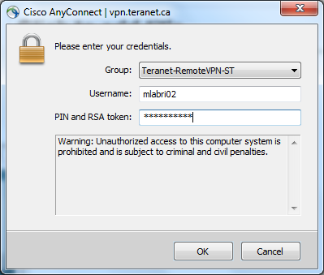

How do I use my RSA token?
Option 1 – Cisco Any Connect
Using your work laptop, connect to the internet, and launch the Cisco Any Connect application
Connect to vpn.teranet.ca then enter your current LAN ID as the Username, and your personal PIN and token code in the Password.
Click OK and you should see a little pop up in the bottom corner of your screen showing you are connected.

Slide 10
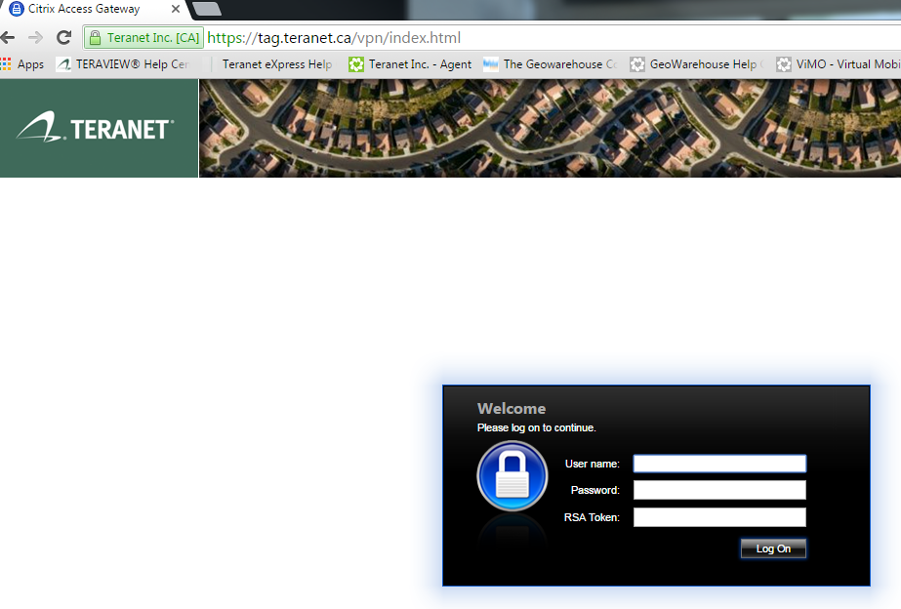
How do I use my RSA token?
Option 2 – Citrix Receiver
Using your home PC or laptop, connect to the internet and go to tag.Teranet.ca
If you have not done so, you will need to do a one time download the Citrix Receiver (see screen shots in the document called “How to download Citrix Receiver”)
If you have already downloaded the Citrix Receiver, you should be able to connect to the network by using your LAN ID credentials as the username and password, your personal PIN and your RSA token code.

Slide 11

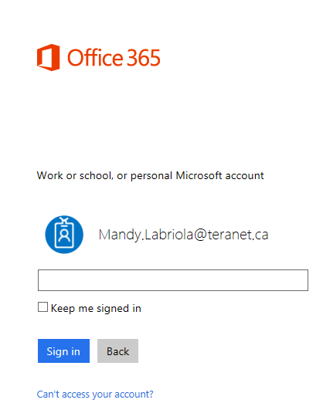
Passwords and Phone numbers
Outlook email password:
If you have internet access from any device and you know your password, you should be able to keep in touch by logging into your work email at https://login.microsoftonline.com/
Phone numbers for:
Service Desk - 416-360-8863 x2222 or ServiceDesk@teranet.ca
Teranet Crisis Management Number 416-643-1051
CSC Conference Bridge
  Local number: 416-343-2285
  Toll-free number: 1 877-969-8433
  Conference ID: 3758634
  (PIN)*: 4571
Mobile numbers:
Everyone’s personal contact info – see document call “ Personal Contact Sheet”
Shelley Williams | 416-576-4570
Kristen Giglio | 416-575-6812
Elaine Jewell | 416-948-5238
Mandy Labriola | 416-476-4811

Slide 12

Contact Information
IS Function | Contact Name
Phones and VPN connectivity issues | Internetworking: Morris Cozz - 416-360-8863 x2480 Mobile: 416-988-0909 Ned Birac - 416-360-8863 x2271 Mobile: 416-931-0556
PC/Desktop Issues | David Hutter: 416-360-8863 x2394 Ryan Davies - 416-360-8863 x2170 Service Desk - 416-360-8863 x2222 John Anderson - 416-360-8863 x2453
Security Issues | George DaSilva - 416-360-8863 x2296 and Mike Coultard - 416-360-8863 x2086
Product Issues | ADS team: Andrew Hunt - 416-360-8863 x2204 Product specific teams: ESR: Anu Surapaneni - 416-360-8863 x2429 Mobile: 416-523-8710 VAS: Cristian Medeleanu - 416-360-8863 x2443 Mobile: 416-254-4346 DP: Ana Fernandes-Payne - 416-360-8863 x2265 Mobile: 416-523-8874 Internal: Trevor Ryan - 416-360-8863 x2498 Pat Hogan - 416-360-8863 x2473 Mobile: 416-540-4504
ESR Line of Business (LOB) | (TV, TEX, TCON, ROS) - Mike Cote - 416-360-8863 x2293 Mobile 416-570-2716 (TV, TEX, TCON, ROS) - Karen Maguire - 416-360-8863 x2569 416-522-3931 (NGTV) - Jennifer Connell -416-643-1100 (LRWAP) - Shree Gupta - 416-360-8863 x2226 Mobile 416-346-5723 (WEF) - Andrew Hughes - 416-360-8863 x2417 Mobile: (416) 524-3416
VAS LOB | (GW, ViMO, PV) - Jeremy Fisher 416-643-1029 (G&U) - Julya Yu - 416-360-8863 x2113
DO Process LOB | (NGTV) - Steve Rawlinson - 416-643-1034 (DP) - Grant Goldrich - 416-322-6111 x1096 (DP) - Sheri Aghlara - 416-322-6111 x2398 Mobile: 416-884-4837 (BC, Emergent & Prosuite) - Cathy Glatiotis - 1-866-367-7648 x2256 Mobile: 778 231 1089

Slide 13
Who Ya Gonna Tell?
The Global address book holds 3 distribution lists to report system issues or anything that impacts Customer Service's ability to support customers.
There is a separate list for ESR, VAS and Do Process. They are labelled as follows:
CSC_ESR <CSC_ESR@teranet.ca>
CSC_VAS <CSC_VAS@teranet.ca>
#DPSL_PDL <DPSL_PDL@teranet.ca>
Use the following template when communicating using these addresses:
  Subject: System Issues re: {insert product or issue}
  Body:
  This is a Customer Service system status update regarding {insert the issue here, remove brackets}
  Report the symptoms of the issues and any other pertinent information here. Example: “Due to the storm, a power outage has occurred making most of the Customer Service team unavailable to provide personal support by telephone. We have limited number of staff providing support over email and live chat channels.
  We will provide more information as it becomes available.

Slide 14
Kahoot time!
Go to kahoot.it and enter game PIN:

Slide 15

Next Steps
  Practice time!!
  A storm has knocked the power out in the city. You are working from home and are able to log in and take calls, however, you notice that it’s only you and one other Agent. It would appear that customers in other areas of Ontario and Canada have power and continue to call in for support. The leadership team is unavailable to ask for help with decision making.
  What should you do?
  Things to consider: Do I stay in the queue? Do I report it and who needs to be notified. Are you only going to support by email? What other things are there to think about? Are internal people calling you? Who else could help in this situation? CMS? Can Ned reroute calls? Once you know you have other support then go back in? How will you handle calls waiting? If you stay out of the queue for the whole day what are you going do instead? Any thing else?

